Slide 1
final project presentation
sourish roy

Slide 2
Research Questions
RQ1: How can we define software development lifecycle model of apps based on the pattern of releases?(Descriptive analysis)
RQ1.1: What is the frequency distribution of the number of releases across various apps?
RQ1.2: What is the frequency distribution of the number of days, weeks or months of app releases on Github ?
RQ2: How do we acquire the topics (for life cycle modelling) based on the commit messages found from the release data of each app? (comparative analysis)
RQ3: Can we define lifecycle stages of an app based on the topics after the topic modeling process? (exploratory analysis)

Slide 3
analysis design sheet

Slide 4
 | Our dataset sample
 | Commit id | Commit Date | Commit message
 | 95901b8b60cb29c6c9d3cffdb7150cb65e34389e | 2012-03-14 18:09:51-07:00 | initial commit
 | fbae248ff3262162204cfdba784f242d9e2c68bc | 2012-03-15 20:47:21-07:00 | clipping bugfix
 | f8fce7d26fbdab6d52db4cf6082c4ed9ab424a50 | 2012-03-15 21:43:31-07:00 | condense train display by destination
 | d9188b723c557e61f6a4410bef27a5c5eaa85bd5 | 2012-03-25 21:57:53-07:00 | Merge pull request #1 from Miserlou/master Icon v1
We collected a data set of approximately 1400 android applications.
Each had a varied number of commit messages (a total of approximately 5000.)
These were present inside raw csv files and in order to analyze it we had to create a text corpus.

Slide 5
Commit information extracted from the dataset
Commit Information | Description
1. ID | An unique identifier for the commit
2. Commit Date | The date on which this commit happened
3. Commit time | The time when this commit happened
4. Commit message | The comment written when the commit is made

Slide 6
RQ1: How can we define Software development lifecycle model of apps based on the pattern of releases? (DESCRIPTIVE ANALYSIS) generated by python scripts

Slide 7
RESULTS
1) APPS WITH LESS THAN 40 TOTAL RELEASES TEND TO HAVE HIGHER RELEASE FREQUENCIES.
FURTHER ANALYSIS SHOWS THAT
2) 70% of the revisions takes place in first 20 days of app release
3) 64% of the total apps have their release time difference of up to 5 weeks
4)70% of the total apps have their release time difference of up to 2 months

Slide 8
RQ2: How do we acquire the topics (for life cycle modelling) based on the commit messages found from the release data of each app? (comparative analysis)
FIRST WE STARTED OFF WITH TOPIC MODELLING CHOOSING AN ARBITRARY NUMBER OF TOPICS.
WE ANALYZED TWO PLAUSIBLE WAYS OF FINDING THE NUMBER OF TOPICS (DISCUSSED LATER)
FOR TOPIC MODELLING WE HAVE FOLLOWED THE FOLLOWING STEPS:

Slide 9
Steps Followed To achieve modelled topics →

Slide 10
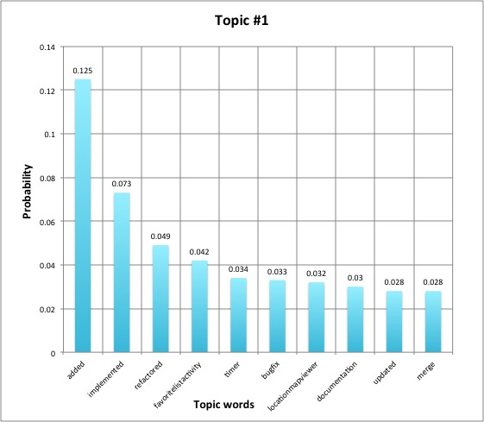
Topic words probability for our first topic (generated by excel)

Slide 11
THE FOLLOWING TOPICS WERE GENERATED
2016-11-06 19:19:18,162 : INFO : topic #0: 0.125*"added" + 0.073*"implemented" + 0.049*"refactored" +
0.042*"favoritelistactivity" + 0.034”timer" + 0.033*"bugfix:" + 0.032*"locationmapviewer" +
0.030*"documentation" + 0.028*"updated" + 0.028*"merge"
2016-11-06 19:19:18,163 : INFO : topic #1 (0.200): 0.072*"icon" + 0.055*"response" + 0.041*"handling" + 0.039*”
improved" + 0.038*"route" + 0.033*"timer" + 0.031*"notification” + 0.031*"local" + 0.031*"test" + 0.031*"reminder”
2016-11-06 19:19:18,163 : INFO : topic #2 (0.200): 0.095*"service" + 0.063*"route" + 0.043*"serve" +
0.036*"text" + 0.034*"touch" + 0.027*"input" + 0.026*"user" + 0.026*"messages" + 0.025*"display"
+ 0.025*"real-time”
2016-11-06 19:19:18,164 : INFO : topic #3 (0.200): 0.060*"add" + 0.052*"merge" + 0.051*"tweakin" +
0.037*"use" + 0.033*"night" + 0.033*"late" + 0.031*"display" + 0.029*"initial" + 0.029*"stations” + 0.028*"absolute”
2016-11-06 19:19:18,164 : INFO : topic #4 (0.200): 0.052*"view" + 0.051*"notification" + 0.051*"remove" + 0.039*”
update" + 0.034*"routeresponse" + 0.034*"service" + 0.031*"begin" + 0.031*"etd" + 0.028*"initial" + 0.027*"check"

Slide 12
NEXT FEW STEPS:
IN ORDER TO SHOW THE SPREAD OF THESE ABOVE CREATED TOPICS IN OUR VECTOR SPACE DURING THE LDA TOPIC MODELLING PROCESS, WE HAVE PEROFORMED 2 MORE COMPUTATIONS:
1) PRINCIPAL COMPONENT ANALYSIS (PCA)
&
2) CLUSTER ANALYSIS
Thus we conducted a comparative analysis between the above two.

Slide 13
PRINCIPAL COMPONENT ANALYSIS AND CLUSTER ANALYSIS
INITIALLY THERE WERE PLENTY OF REDUNDANT DIMENSIONS CREATED AFTER IMPLEMENTING GENSIM LIBRARY’S VECTOR SPACE TO CREATE THE LDA MODEL.
SO WE DECIDED TO REDUCE THE NUMBER OF REDUNDANT DIMENSIONS INTO A 1 DIMENSIONAL SPACE.
THIS ALSO HELPS US SEE THE SPREAD OF TOPICS (IN THIS CASE 5) IN THE 1 D VECTOR SPACE.
generated using python scripts

Slide 14
PCA GRAPH and clusters GENERATED AFTER TOPIC MODELLING

Slide 15
things covered and things left to be done →

Slide 16
How to get the number of topics for topic modelling
There were 2 processes which we had followed to achieve this :
K- Means Cluster analysis and
Perplexity Analysis
This helps us in validating the results and to see which of the two techniques are more feasible and less time consuming.

Slide 17
K Means For the BART APP (Using Python’s scikit learn library)
We chose 5 topics as the value of K

Slide 18
Perplexity analysis
GENSIM provides us an option of perplexity analysis to select the number of topics based on the perplexity value. So we ran the same test on the same app named “bart”.
The results were slightly different.
Let’s take a look at the results of our perplexity analysis once by selecting 10 topics and then by reducing the number of topics.

Slide 19
results
For 10 topics:
-13.445 per-word bound, 11152.3 perplexity estimate based on a held-out corpus of 93 documents with 139 words
For 5 topics :
-8.940 per-word bound, 491.3 perplexity estimate based on a held-out corpus of 93 documents with 139 words
for 3 topics :
-7.608 per-word bound, 195.1 perplexity estimate based on a held-out corpus of 93 documents with 139 words

Slide 20
validity check
as the perplexity estimate value keeps on decreasing we start getting a clearer picture of the number of topics to select.
anything below the value of 500 is an excellent choice as we have figured out experimentally.
for the app bart 3 is an ideal number of topics.
so perplexity analysis is a better option to choose among the 2 because of 2 major reasons:
1) Accuracy (since K means mostly points at 5)
2) ease of computation (also lesser lines of code)

Slide 21
similarity amongst the topics of the same app
For this purpose we performed a comparative analysis between 2 more techniques:
1) Hierarchy analysis
2) Network analysis
In this case our main concern is how closely related the probabilities of each app are. Thus highlighting the intimacy between each topic of a particular app.

Slide 22
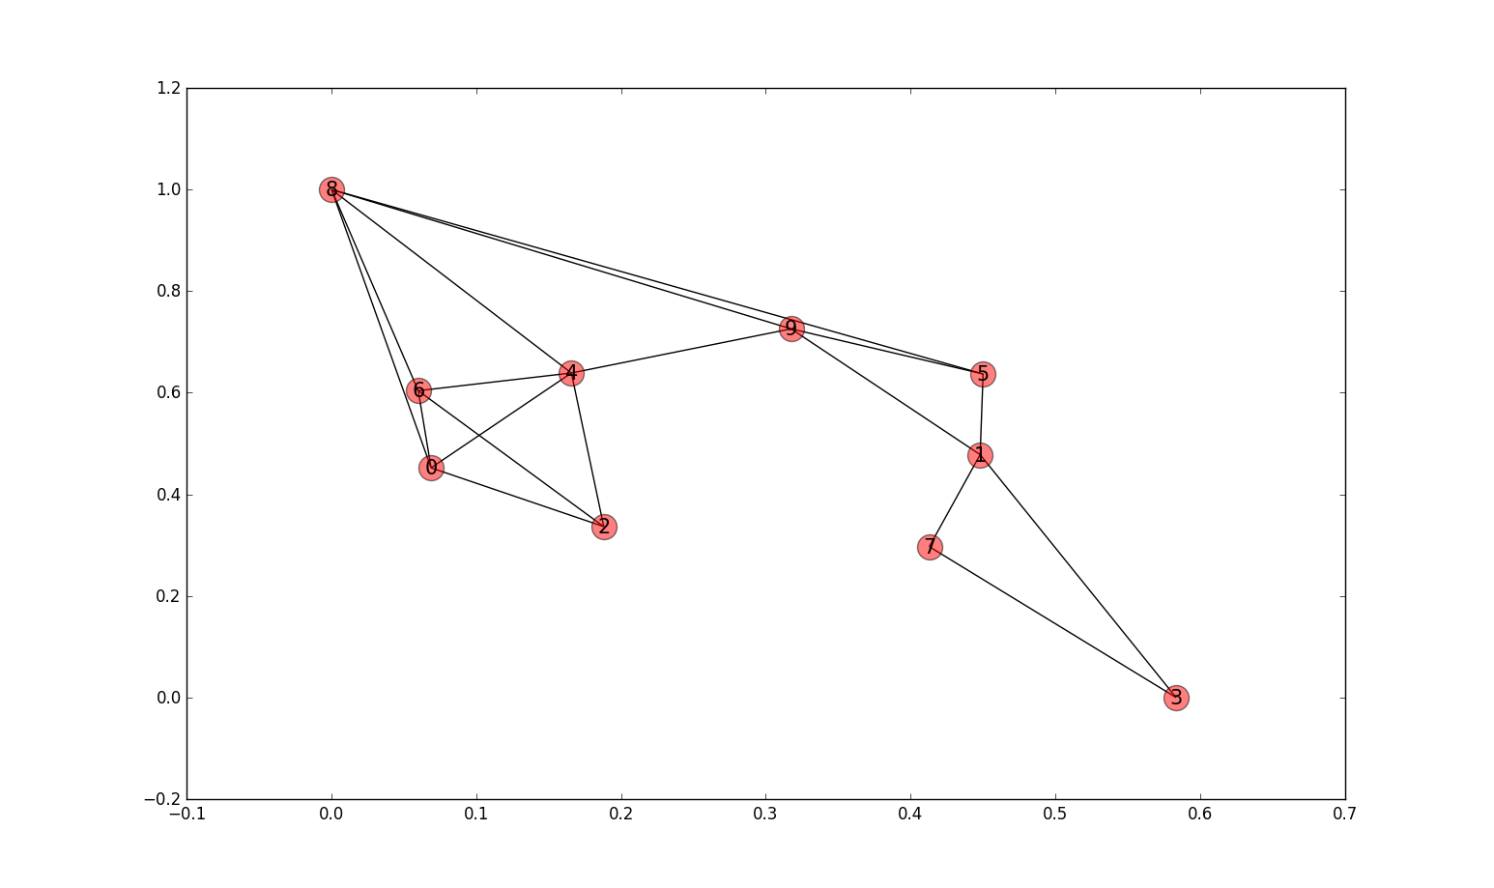
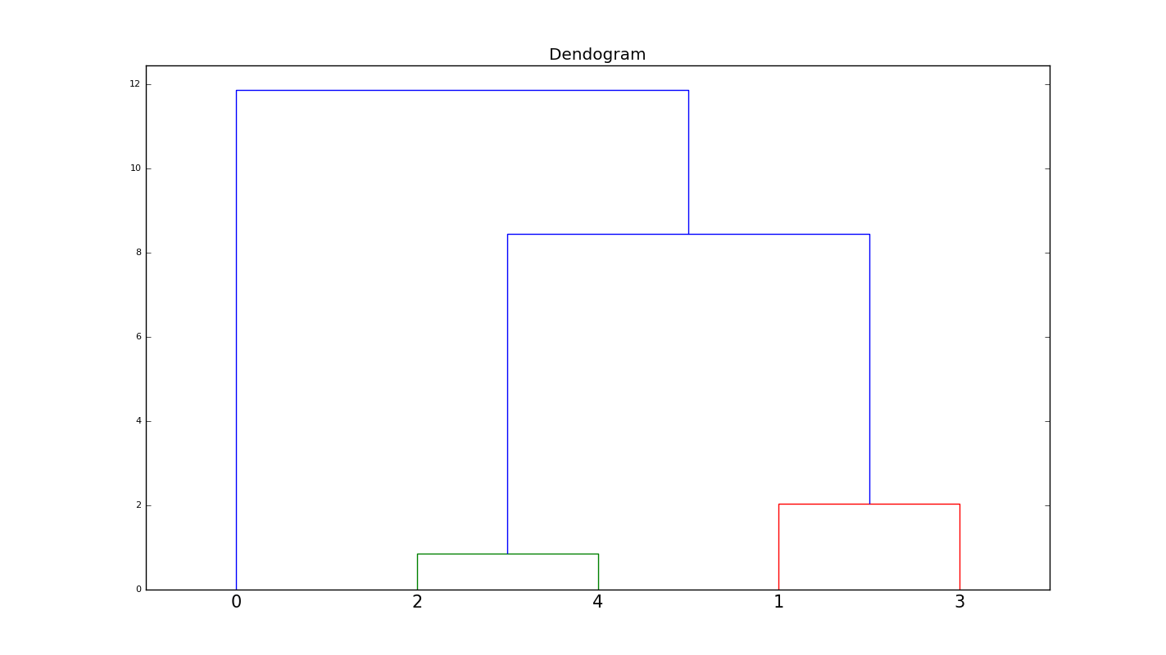
The Network graph and the hierarchy (generated by python)

Slide 23
RQ 3 (An exploratory analysis)
Can we define the lifecycle stages of an app based on the topics after the topic modeling process?

Slide 24
Similarity analysis between separate documents
the previous analysis helped us in grouping similar topics of the same app.
But our main concern is to observe the similarities of 2 apps based on commit topics.
For example app 1 and app 2 are similar for the commit topic 5.
this would help us in grouping similar apps under the same topic.
We can later check the results and model the similar apps under a particular life cycle stage of a software development lifecycle model.

Slide 25
SIMILARITY ANALYSIS
BETWEEN TWO DOCUMENTS:
SHOWS THE SIMILARITY BETWEEN TWO FULL DOCUMENTS.
HELPS US REALIZE THE RELEVANCE OF TWO APPS AND WOULD HELP US CATEGORIZE THEM.
But what is more interesting is to figure out the similarity of apps in terms of commit topics instead of the whole document.

Slide 26
analysis
We compared the topics of two apps batphone and bart :both had 3 topics
our result was the following:
[(0, 0.18635691041580779), (1, 0.64397432426124468), (2, 0.16966876532294756)]
we then set a threshold value of 0.5 for similar topics. Anything above 0.5 suggests that these two commit topics are similar for the two apps.
In this case topic 2 has a value of 0.644 (>0.5) and thus we can say that the topic 2 is similar for both the apps.
Similarly we conducted this experiment for 5 apps.
for better similarity analysis we choose a minimum of 5 topics to clearly see which life cycle stage these apps belong to.
So each of of the apps we compare have 5 topics.

Slide 27
a table that shows apps which share similar topics
 | BART | Campyre | WifiFixer | Zxing | KindMind
BART | ------------- | ---------------- | --------------- | Topic 2 | ------------
Campyre | --------------- | --------------- | --------------- | ------------------ | --------------
WifiFixer | Topic 0 | Topic 0 | ----------------- | Topic 0 | Topic 0
Zxing | ------------ | Topic 4 | Topic 0 | ------------------- | Topic 1
KindMind | Topic 0 Topic 1 | Topic 0 Topic 1 | Topic 0 Topic 1 | Topic 0 | ------------------

Slide 28
Labeling the topics : WE labeled the topics based on the term probabilities and the commit files to get a sensible label . This would later help us understand which life cycle stage (if any) the app belongs to.
BATPHONE
BART
CAMPYRE
TOPICS | TERMS | LABELS
Topic 1 | translation, Russian, update, fixed, strings | Push requests
Topic 2 | last, beta, French, commit, fix | Revisions
Topic 3 | Issue, fix, bug, reverted, changed | Bug fix
Topic 4 | Added, version, setup, sipdroid, initial | Version control
Topic 5 | fix, issue, beta, small, support | Issue handling
TOPICS | TERMS | LABELS
Topic 1 | service, display, begin, route, main | Initial plan
Topic 2 | service, remove, route, add, visual | Implementation
Topic 3 | icon, notification, timer, reminder, time | Push Notifications
Topic 4 | onresume, initial, routeresponse, use, special | Analyze
Topic 5 | merge, improved, handling, service, tweaks | Bug Handling
TOPICS | TERMS | LABELS
Topic 1 | room, screen, android, files, roomlist | Monitoring logs
Topic 2 | moved, asynctask, speaking, room, join | synchronization
Topic 3 | login, added, roomlist, comments, room | Login information
Topic 4 | renamed, whitespace, campfire, removed, added | Modifications
Topic 5 | readme, updated, added, moved, room | Implementation

Slide 29
THE PREVIOUS TABLE WITH LABELLED TOPICS
 | BART | Campyre | WifiFixer | Zxing | KindMind
BART | ------------- | ---------------- | --------------- | Bug Fixing | ------------
Campyre | --------------- | --------------- | --------------- | ------------------ | --------------
WifiFixer | Bug Fixing | Bug Fixing | ----------------- | Bug Fixing | Bug Fixing
Zxing | ------------ | Issue Fixing | Release Rollback | ------------------- | Code Changes
KindMind | Bug Fixing Modifications | Bug Fixing Modifications | Bug Fixing Modifications | Bug Fixing Modifications | ------------------

Slide 30
Life cycle modelling
BATPHONE
BART
KINDMIND
ZXING

Slide 31
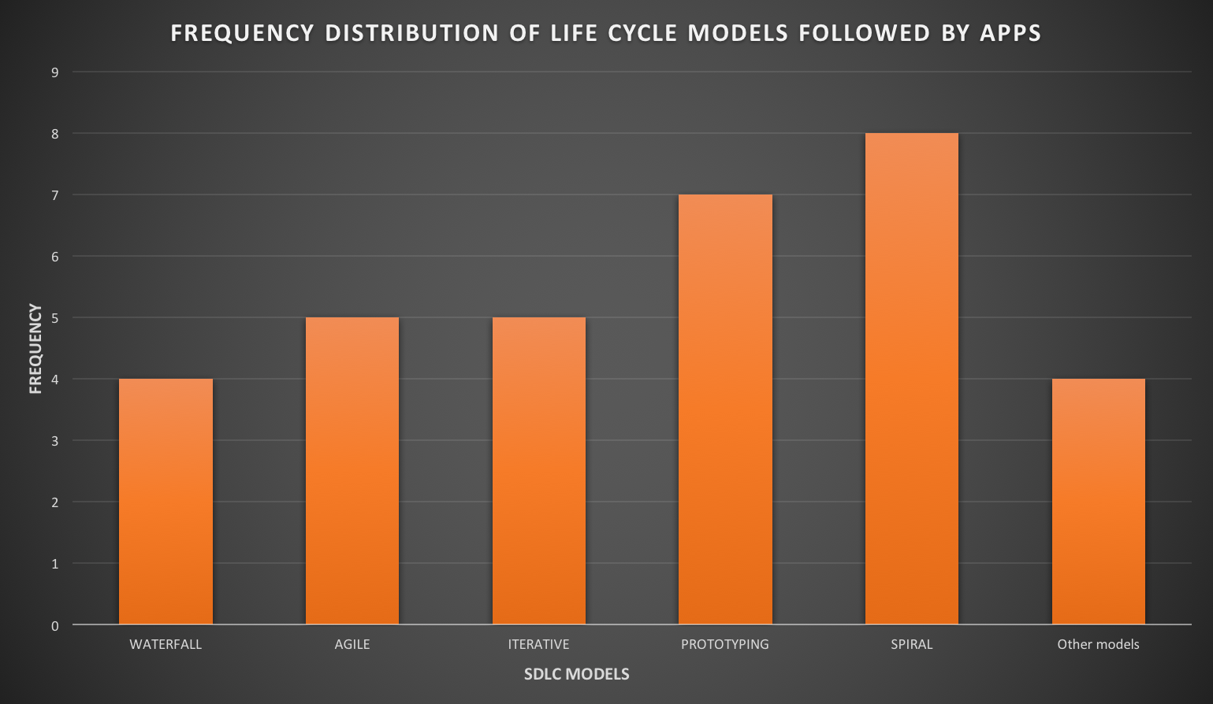
Generated by excel

Slide 32
References
[1]Panichella, Annibale, et al. "How to effectively use topic models for software engineering tasks? an approach based on genetic algorithms." Proceedings of the 2013 International Conference on Software Engineering. IEEE Press, 2013.
[2]A. De Lucia, M. Di Penta, R. Oliveto, A. Panichella, and S. Panichella, “Using ir methods for labeling source code artifacts: Is it worthwhile?” in IEEE 20th International Conference on Program Comprehension (ICPC’12), Passau, Germany, June 11-13, 2012, pp. 193–202.
[3] http://scikitlearn.org/stable/modules/generated/sklearn.cluster.KMeans.html
[4] Hindle, Abram, Daniel M. German, and Ric Holt. "What do large commits tell us?: a taxonomical study of large commits." Proceedings of the 2008 international working conference on Mining software repositories. ACM, 2008.
[5] http://www.nltk.org/book/ch02.html
[6] Dr. Drrpshikha Jamwal “Analysis of software Development Models”, ISSN: 2229-4333 (print), ISSN:09768491 (online), vol. 1ISSUE 2, December 2010.

Slide 33
THANK YOU!!

